Slide 1

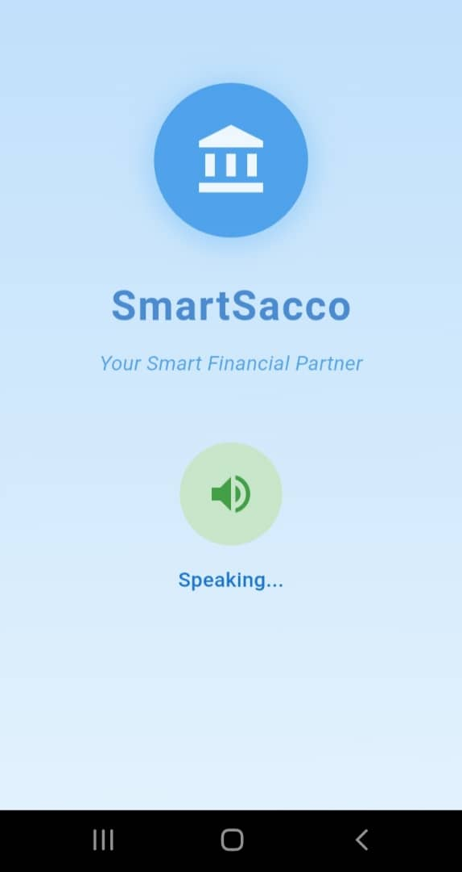
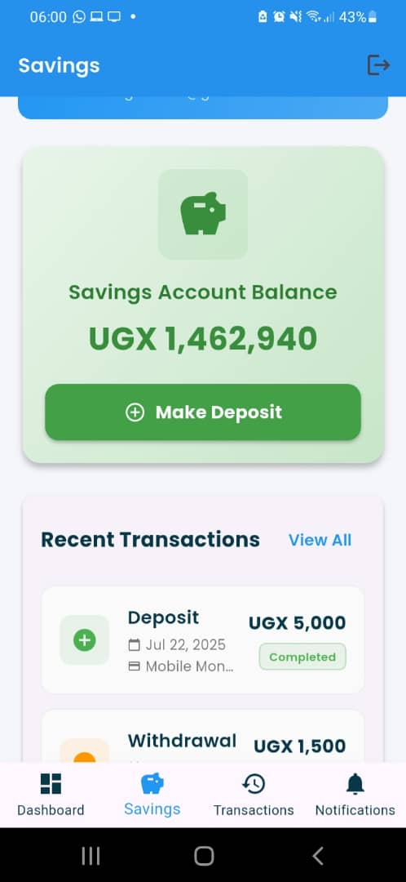
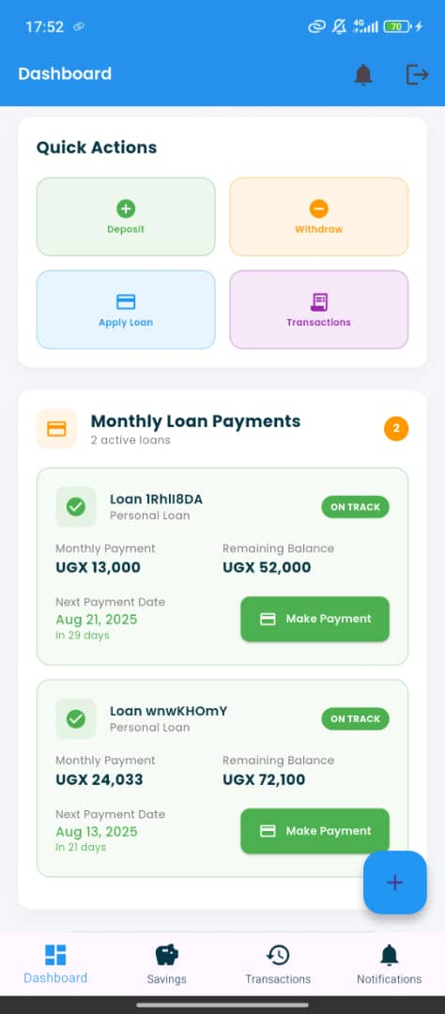
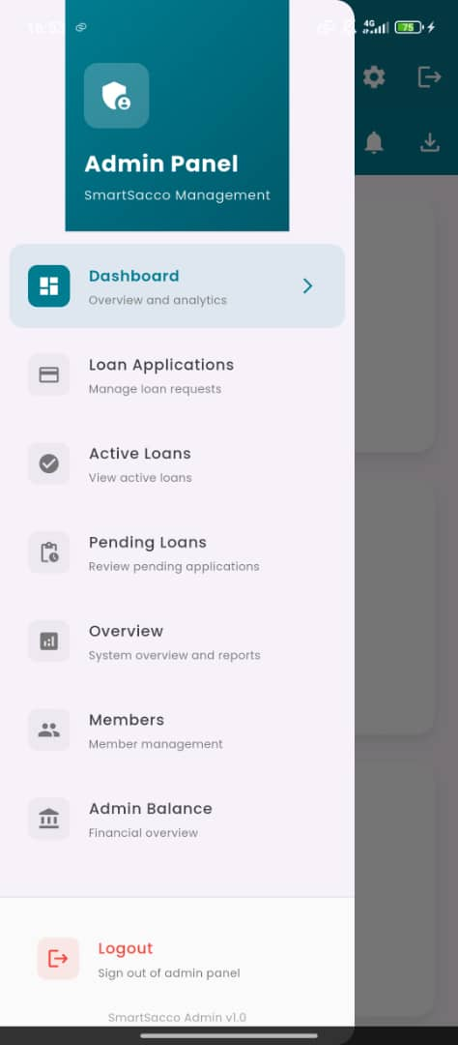
SMART SACCO
Ageno Elizabeth | Odyek Benard | Tino Zoe Ramona | Nangobi Lydia
NAMES 1.AGENO ELIZABETH 2.TINO ZOE RAMONA 3.ODYEK BENARD 4. NANGOBI LYDIA | STUDENTS NUMBER 2400725850 2400711508 2400724660 2400724537 | REGISTRATION NUMBER 24/u/25850/PS 24/U/11580/PS 24/U/24660/PS 24/U/24537/PSA
Project Design
Results
SMART SACCO SYSTEM (Firebase/Firestore Backend + Mobile APIs)
Problem
USER HUB
Visually Impaired
Sighted Users
Member Role
Admin Role
API GATEWAY
Mobile Money
Email
Firebase Auth
Financial Insecurity: Manual record-keeping leads to errors, fraud, and lost savings.
Accessibility Barriers: People with disabilities (specifically visual) cannot use traditional SACCO services.
Operational Inefficiency: Slow, paper-based processes require physical visits, delaying transactions.
Lack of Trust: No real-time transaction tracking or audit trails, enabling fraud.
FIRESTORE DB
Users
Transactions
Loans
CLOUD FUNCTIONS
Transactions
Loan Processing
Notifications
ADMIN
Approve/Reject Loans
View All Transactions
Sacco Analytics (Total savings, members etc.)
Payout disbursement
Project Objectives
Results
Primary:
Make SACCO services accessible (voice navigation, screen reader support).
Automate processes (mobile money integration).
Build trust via transparent account dashboards.
Secondary:
Expand financial inclusion for marginalized groups.
Scale regionally across East Africa.
SPLASH SCREEN
This is an accessibility-friendly splash screen that offers voice navigation for visually impaired users and touch interaction for sighted users to begin using Smart Sacco mobile application.
MEMBER DASHBOARD
Personalized SACCO dashboard displaying key account details—including savings balance, active/pending loans, transaction history, and quick actions—all in one place.
LOANS/TRANSACTIONS
Loan management dashboard providing a clear overview of active loans, including payment amounts, due dates, and remaining balances, with immediate options to settle payments.
ADMIN DASHBOARD
Admin panel providing tools to manage loans, members, and finances, with quick access to applications, reports, and system overview.
RESULT 1
Seamless accessibility for both visually impaired and sighted users.
Simplified interface.
RESULT 2
Real-time financial tracking and reporting.
Automated loan application.
Digital payment system.
Member self-service capabilities.
Comprehensive admin oversight tools
RESULT 3
Intuitive dashboard designs with key metrics.
Quick action buttons for common tasks.
Visual progress tracking.
Seamless transaction history.
Responsive design across all devices.
Project Requirements
Conclusion
R1. Functional:
Real-time balance tracking.
Mobile money integration.
Accessibility features (voice UI, high-contrast mode).
R2. Non-Functional:
Fast performance (1,000+ users).
Scalable cloud backend.
Hypothesis Supported:
Blind users completed voice transactions as intended.
Sighted admins managed loans/analytics securely.
Mobile money API worked with 99% success rate.
Critical Limitation:
Blind users cannot withdraw funds or be admins due to voice authentication security risks.
Conclusion:
The design works as intended but withdrawal/admin restrictions for blind users remain necessary for security. Future versions could explore secure voice alternatives for limited admin tasks.
Future Work
Target Users
Observation 1:
Enhanced Voice Authentication.
Develop multi-factor voice biometrics (voiceprint + PIN) to potentially enable secure withdrawals for blind users.
Observation 2:
Voice Loan Application:
Take photo of loan form → System reads fields aloud, fields auto-completes with voice input.
Observation 3:
Enable banking transactions with smart sacco users.
Enable future saving plans for users who are interested.
Members
General and Visually impaired users use the application;
Frontline Administrator
Administrators use this application to;
External Partners
(MTN)
Mobile networks use the system to;
Process registrations.
Generate reports.
Review transactions.
To increase customer growth, Encourages unbanked mobile money users to join SACCOs, expanding the networks’ financial ecosystem.
Earn transaction fees from SACCO-related transfers, boosting their mobile money business.
Mobile networks can track SACCO-linked transactions for fraud monitoring and regulatory reporting.
Eliminates Manual Errors.
approve loans.
help members with transparent operations.
monitor finances.
set policies.
ensure compliance.
To check balances,.
To send money
For faster loan processing
To get alerts.
To Bank Independently.
To Participate Fully in SACCO Membership.
Grow savings without dependency on others.
To Secure money, especially the visually impaired.
Overcome braille limitations through speech-based banking
References
Flutter Team. (2023). Flutter Documentation. [Online] Available at: https://flutter.dev/docs. For mobile app development.
Google. (2023). Firebase Documentation. [Online] Available at: https://firebase.google.com/docs. For Backend services(Firestore,Auth,Cloud Functions)
Google Cloud. (2023). Speech-to-Text API Documentation. [Online] Available at: https://cloud.google.com/speech-to-text/docs. For voice input processing for visually impaired users.
Flutter TTS Package. (2023). flutter_tts. [Online] Available at: https://pub.dev/packages/flutter_tts
MTN Group. (2023). MoMo API Developer Guide. [Online] Available at: https://momodeveloper.mtn.com/documentation/. For Mobile money transactions(deposits/withdrawals)
Notes:
To change this poster, replace our sample content with your own. Or, if you'd rather start from a clean slate, press the New Slide button on the Home tab to insert a new page. Now enter your text and pictures in the empty placeholders. If you need more placeholders for titles, subtitles or body text, copy any of the existing placeholders, then drag the new one into place.

